Slide 1
Self Learning Tutorial: Insurance Status and Healthcare Outcomes
An analysis using MIMIC-III data, Matplotlib, Seaborn, Sklearn Models, PCA, T-SNE, SHAP interactions, Kaplan Meier, and K-Means Clustering
Notes:
https://github.com/jared-moore-dev/UTAUSTIN/blob/main/AI%20in%20Healthcare/Assignment%205%3A%20Self%20Learning%20Tutorial/SLT.ipynb

Slide 2
Tutorial Agenda
Introduction
Motivation
Project Goals
Data Preparation and Exploratory Data Analysis
Feature Engineering
Focused Data Analysis
Prediction Model for Mortality and Readmission
PCA & T-SNE
Advanced Data Analysis
SHAP Values
Kaplan-Meier Survival Curves
K-Means Clustering
Notes:
This slide outlines the key sections of this tutorial.
We will start with an introduction, covering motivation and project goals.
Then, we move on to data preparation, exploratory analysis, feature engineering, and specific analyses.
We’ll cover predictive modeling, PCA, T-SNE, SHAP values, survival analysis, and clustering.
By the end, you will have a structured approach to analyzing healthcare disparities using ML.

Slide 3
Motivation
The health insurance industry is an industry I have worked in to varying degrees since 2019. With the interesting data being provided in this class, I was curious what the effect of Insurance is on health outcomes and what trends can we see in the demographics of data related to insurance. Especially with the frustration many have with utilizing and paying for healthcare in the United States, I wondered how different types of insurance were correlated with medical standards of care.
Notes:
I have worked in the health insurance industry since 2019, which inspired my interest in this topic.
Many people experience frustrations with healthcare costs and accessibility in the U.S.
This project investigates how insurance types correlate with healthcare outcomes.
Specifically, I aim to analyze disparities in medical care standards across different insurance groups.

Slide 4
Project Goals
This tutorial aims to:
Explore the distribution of insurance types within the MIMIC-III dataset.
Analyze the relationship between insurance status and key healthcare outcomes, such as length of stay, readmission rates, and mortality.
Identify potential disparities in treatment patterns across different insurance groups.
Provide practical examples of data analysis techniques using Python and relevant libraries (e.g., pandas, NumPy, scikit-learn, matplotlib, seaborn).
Provide clear and concise code examples.
Notes:
This project aims to:
Explore the distribution of insurance types in the MIMIC-III dataset.
Analyze relationships between insurance status and healthcare outcomes.
Identify disparities in treatment patterns.
Demonstrate ML-based analytical techniques in Python.
Ensure code clarity for reproducibility.

Slide 5
Data Preparation and Exploratory Data Analysis

Slide 6
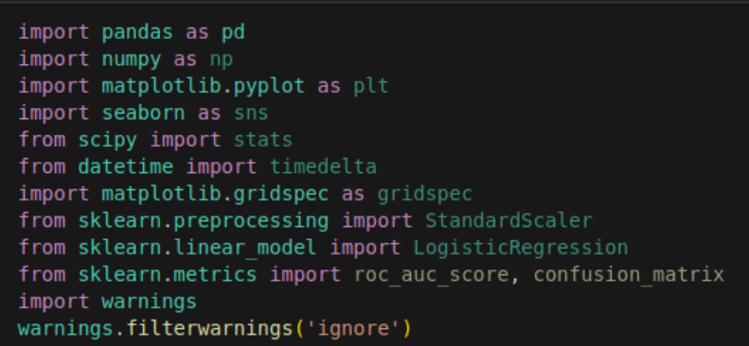
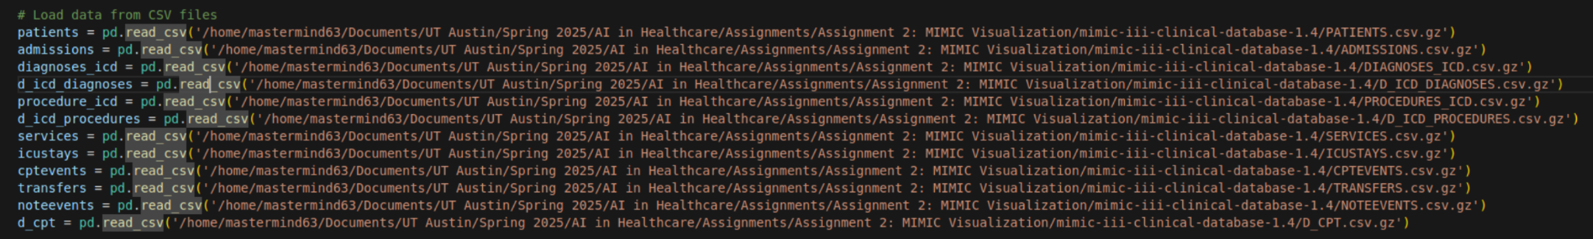
Loading MIMIC-III Data
First load all of the relevant libraries
Next import data from the csv files into tables in pandas we can work with
Notes:
The first step was loading MIMIC-III data using Python libraries like Pandas.
We prepared the data by cleaning and organizing relevant features.
The dataset was analyzed to understand its structure before modeling.

Slide 7
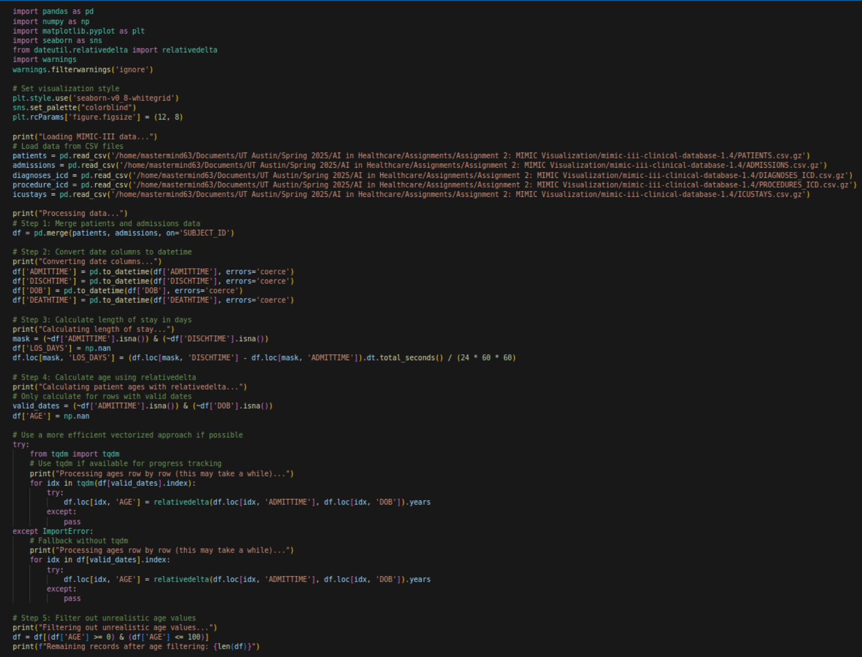
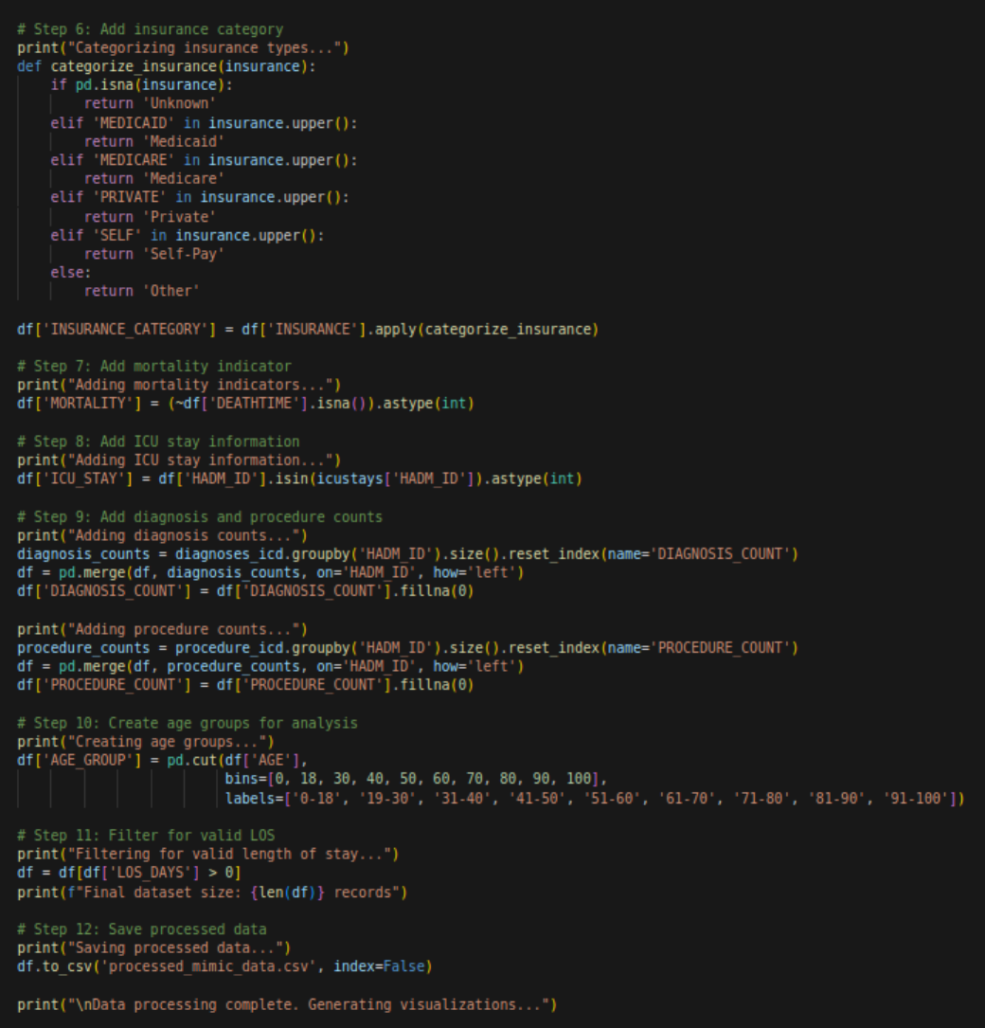
Exploratory Data Analysis: Research Questions and Code
Notes:
Our EDA focused on key research questions:
How does insurance type impact mortality and readmission rates?
Do different insurance types influence hospital length of stay?
Are there noticeable disparities across demographic groups?
Python code was used to generate summary statistics and visualizations.

Slide 8
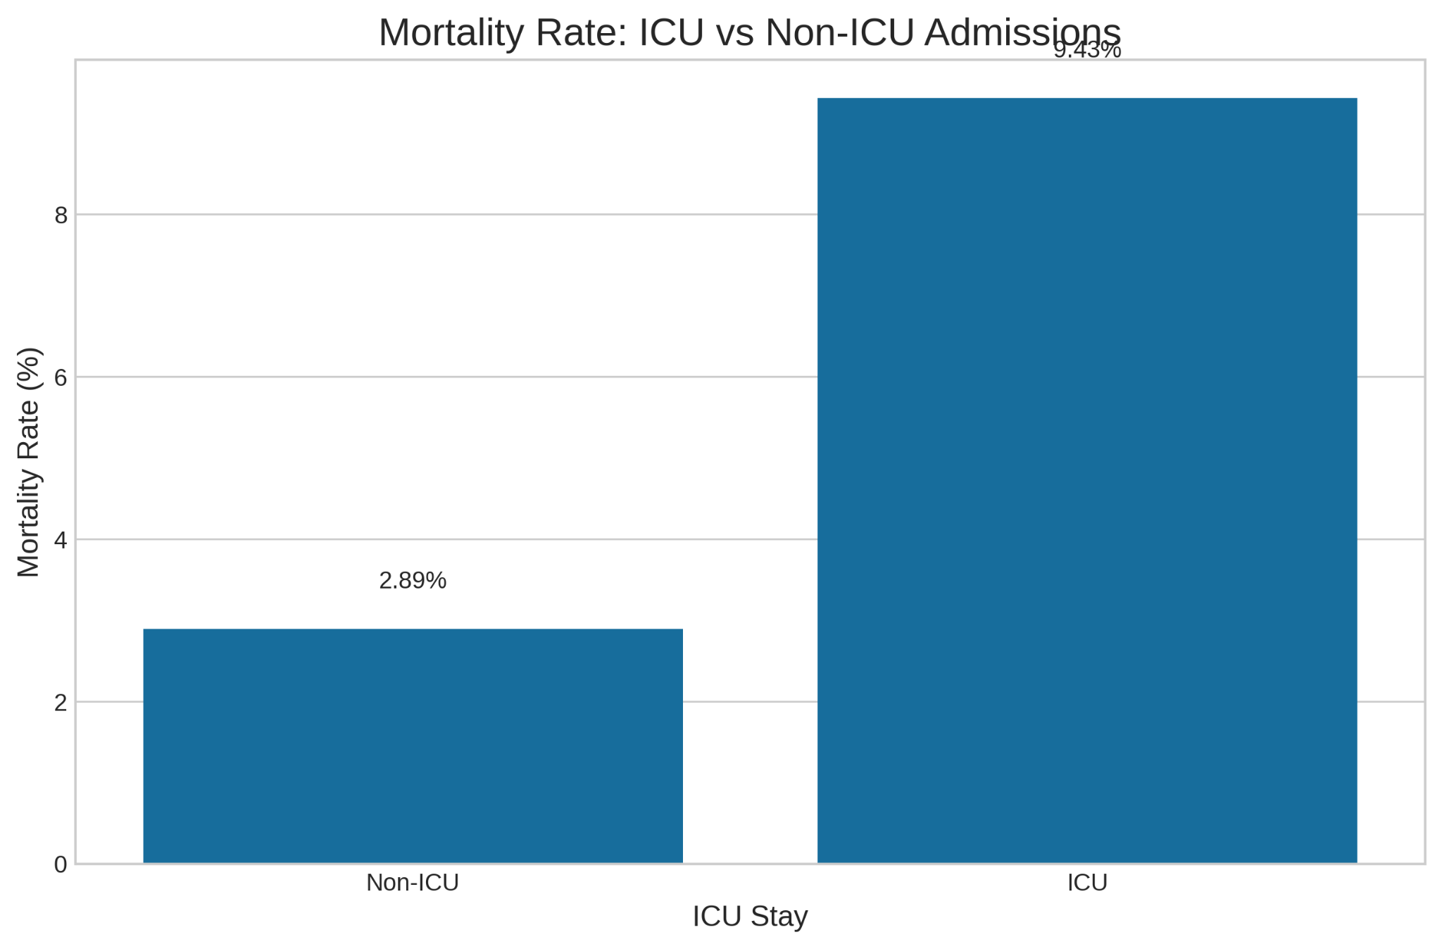
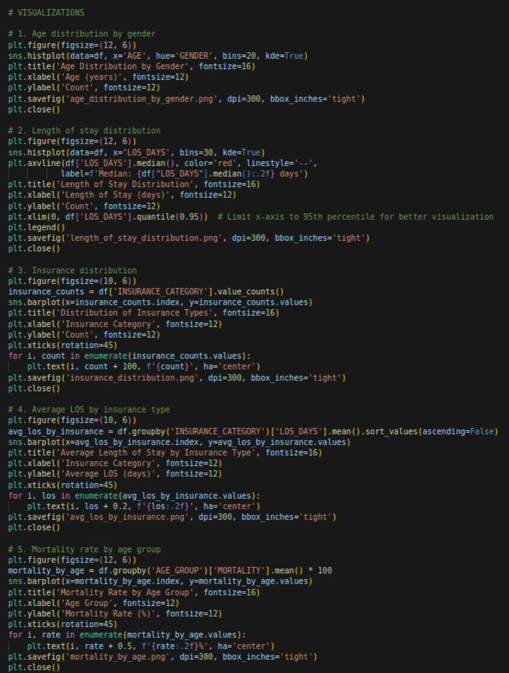
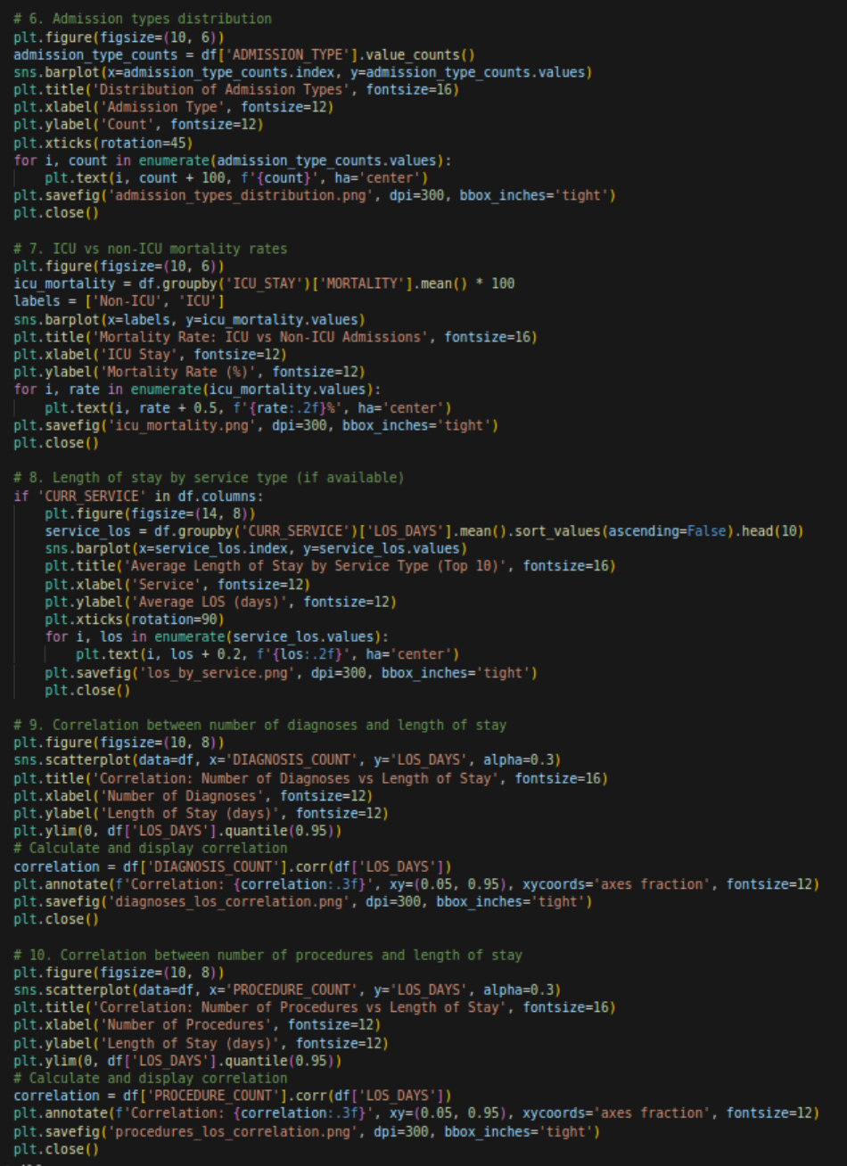
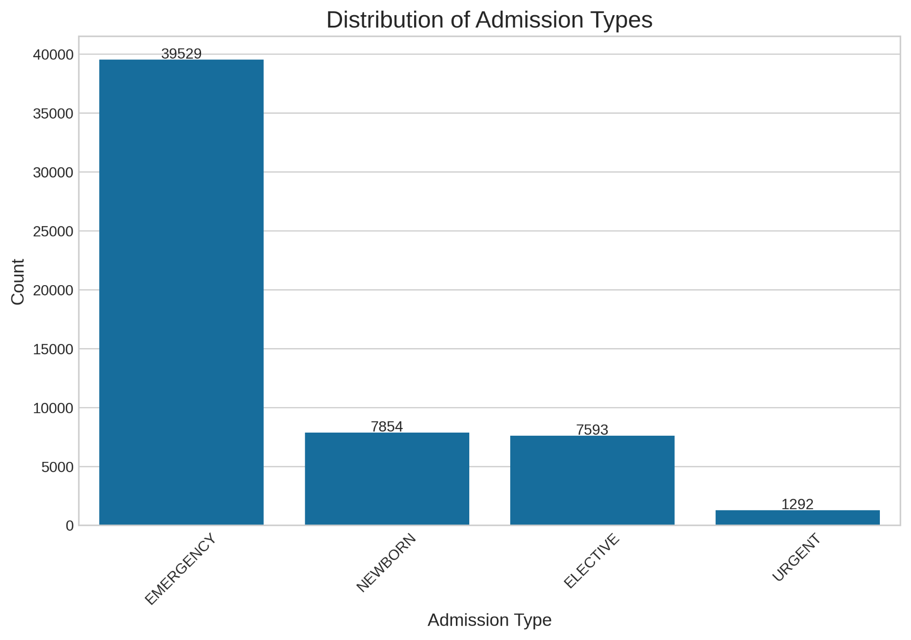
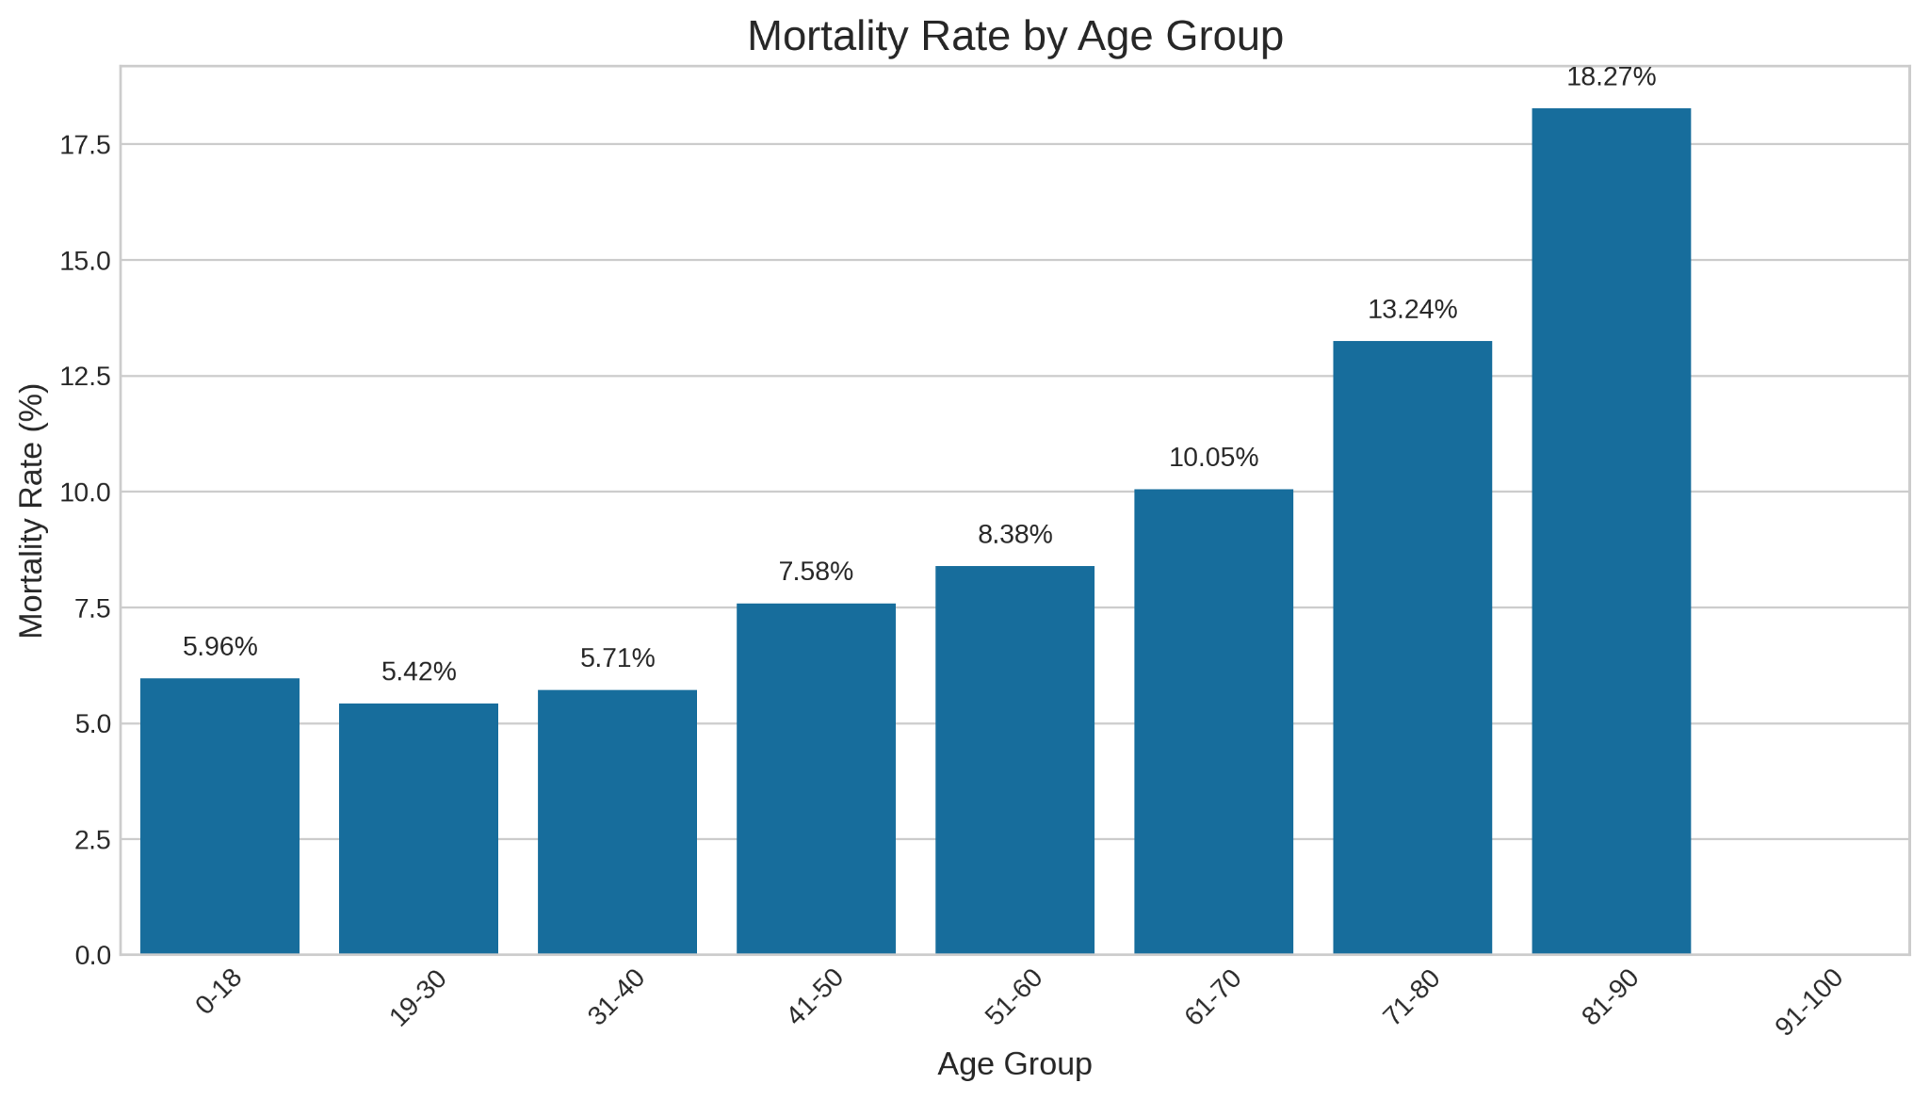
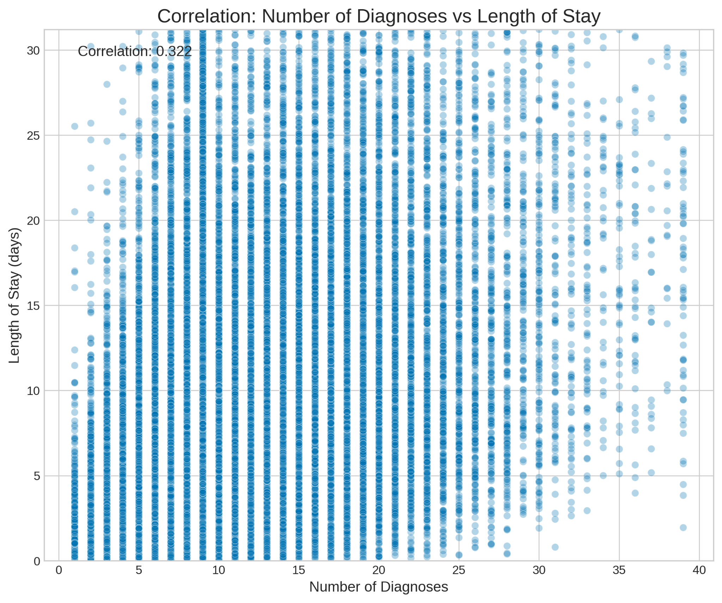
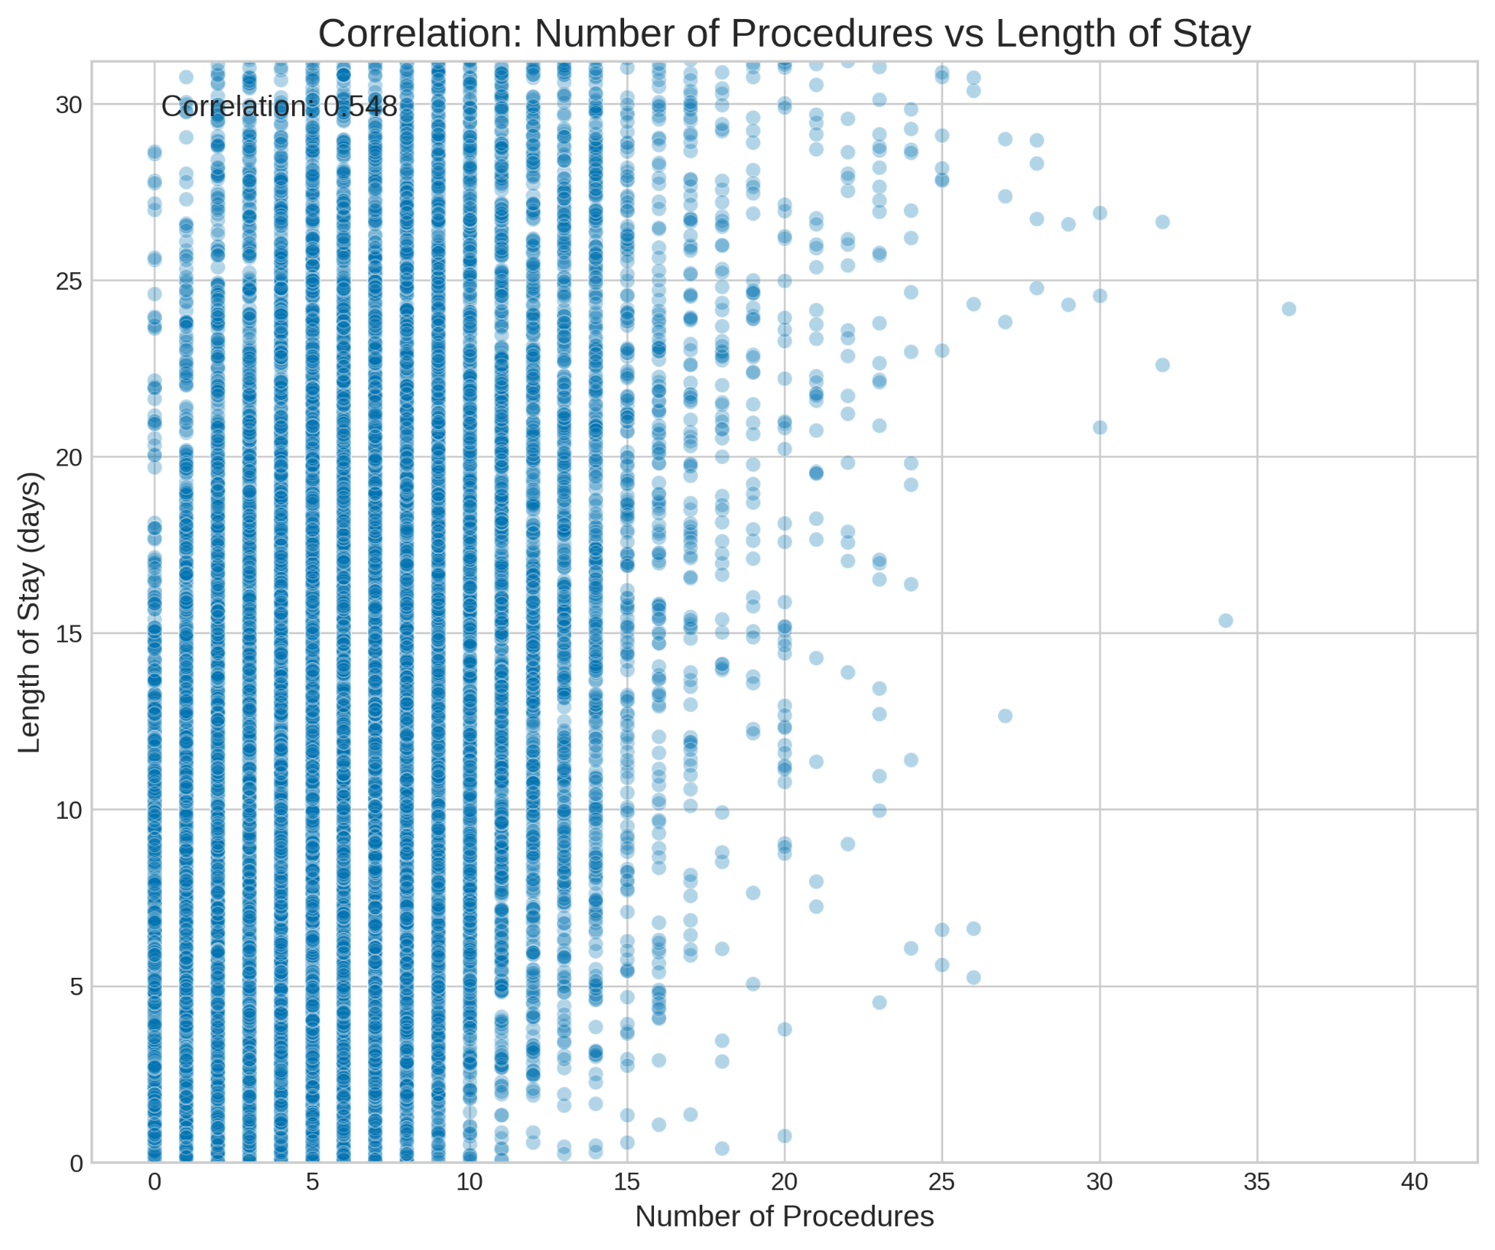
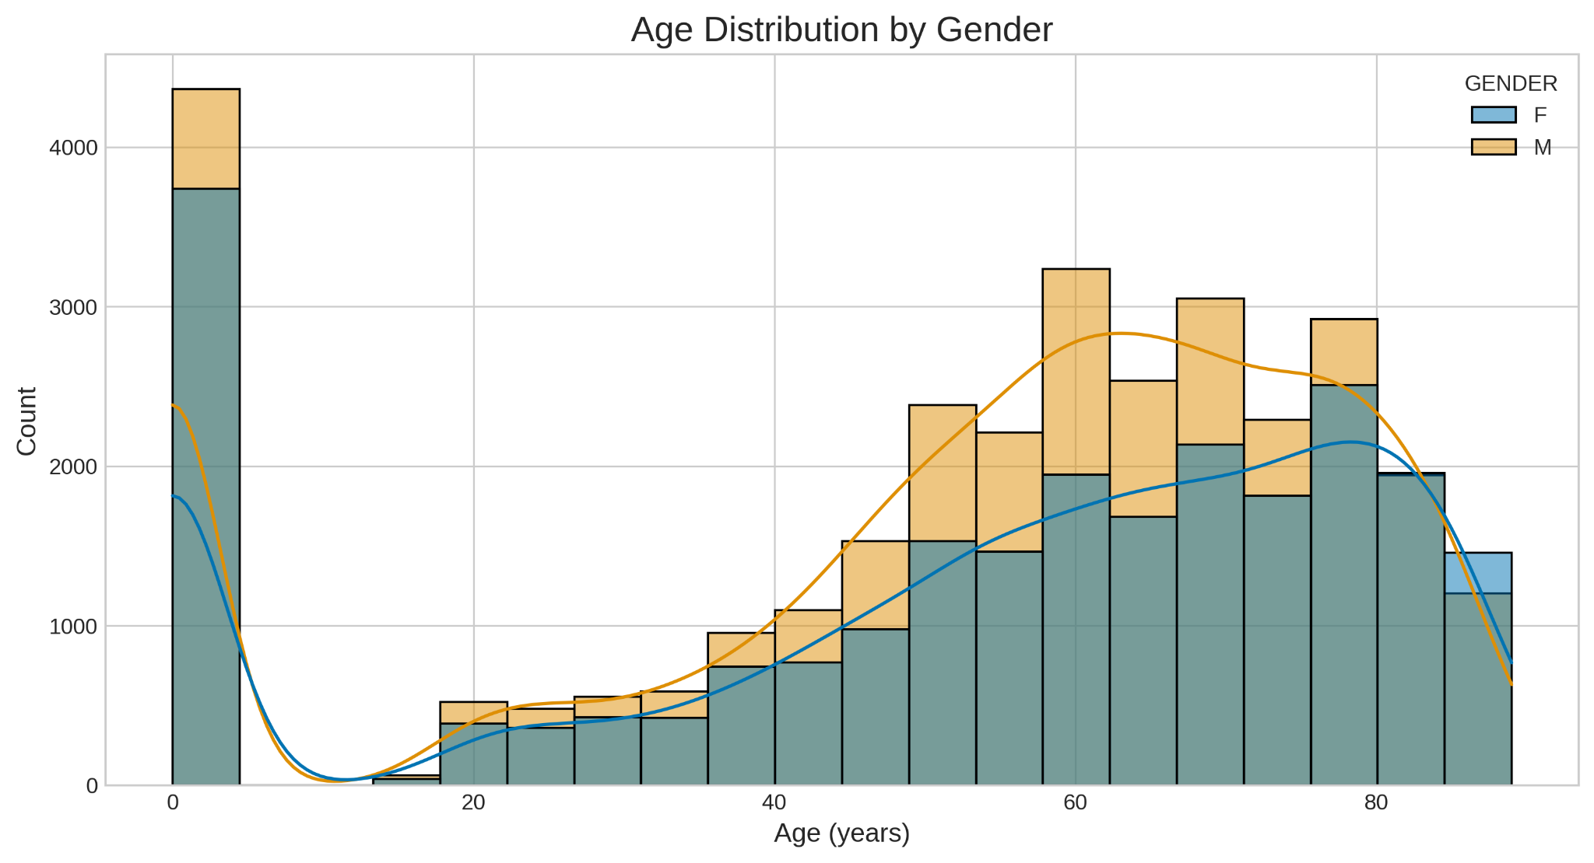
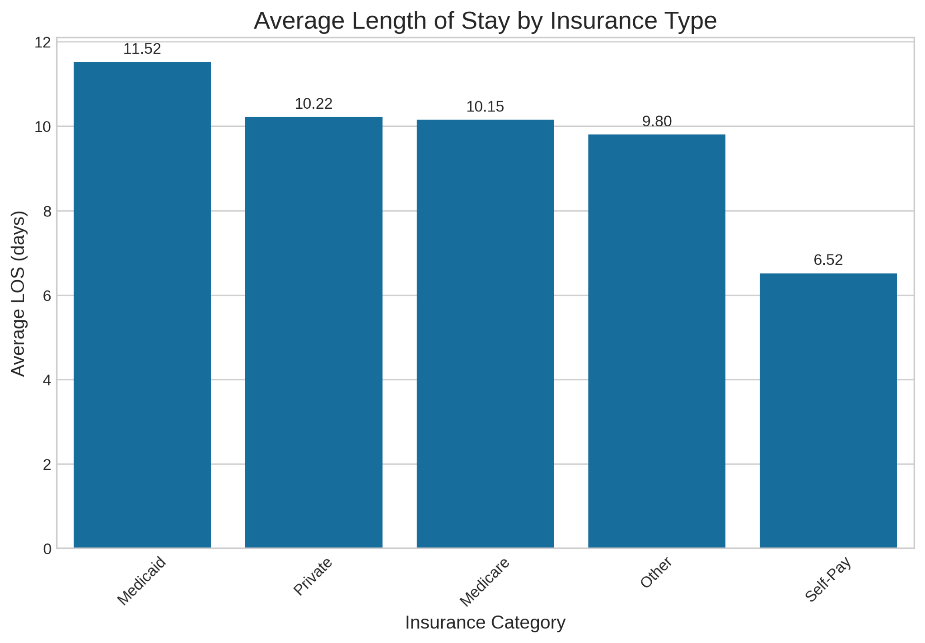
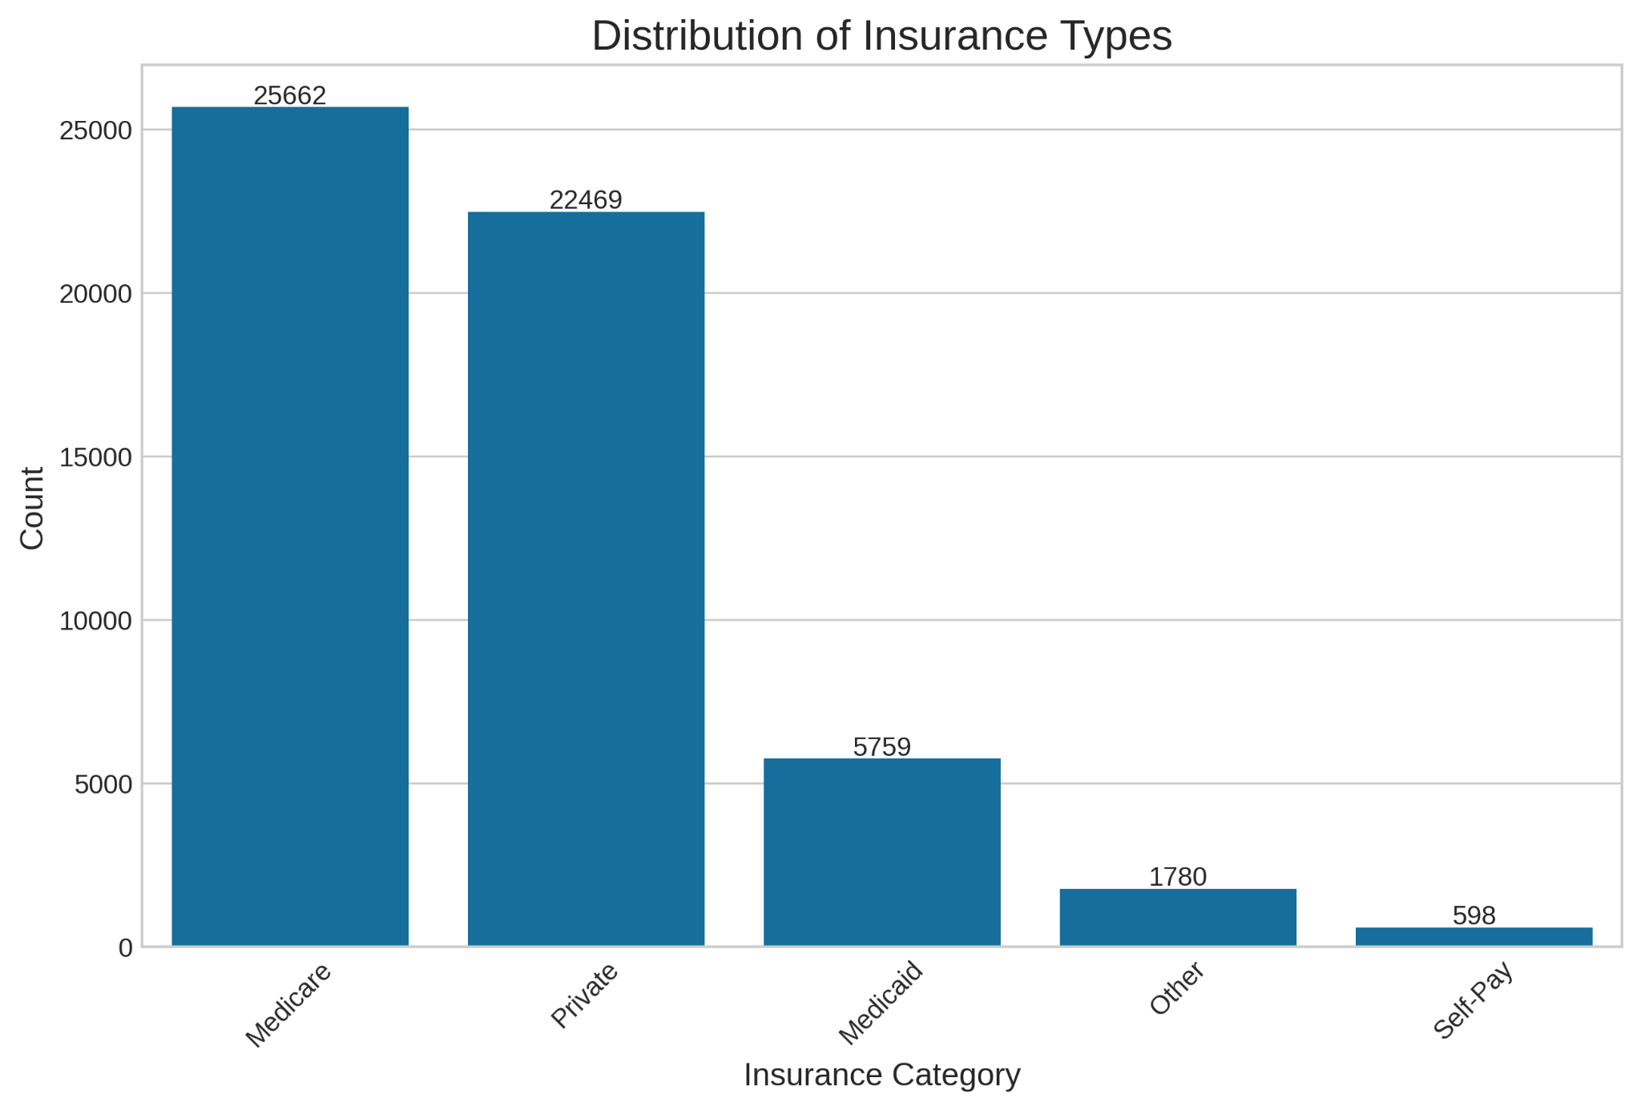
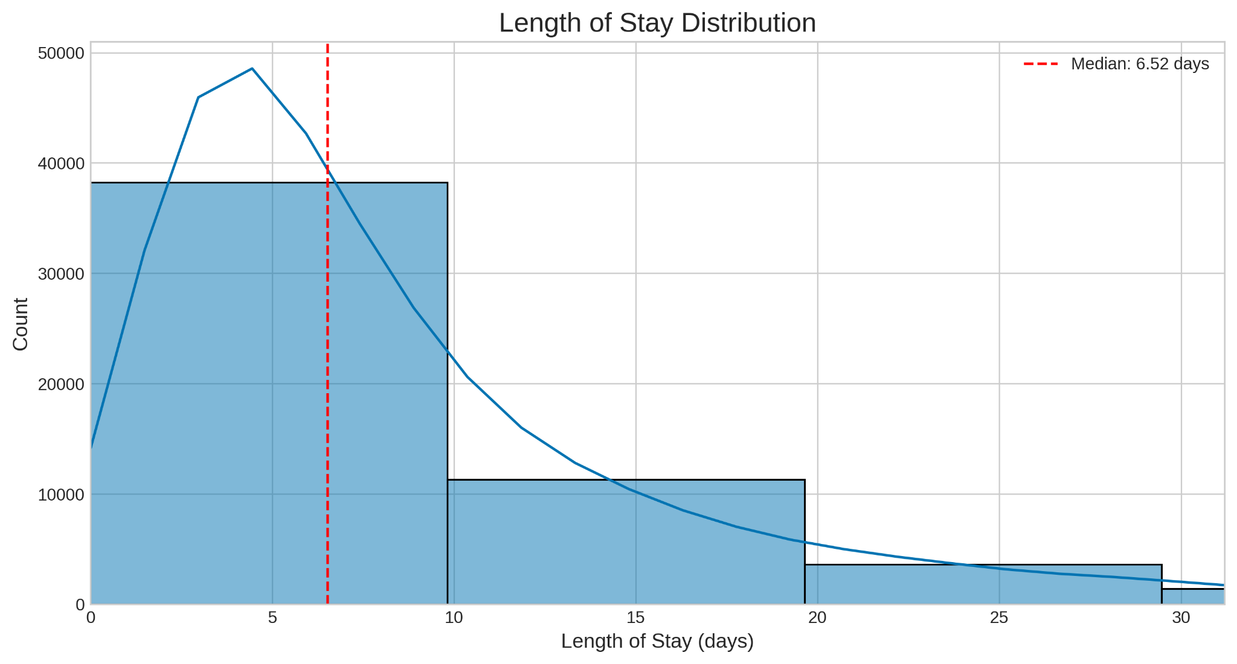
Exploratory Data Analysis: Visualizations
Notes:
Visualizing data helps uncover patterns that may not be obvious in raw numbers.
Histograms, bar charts, and boxplots were created to compare insurance groups.
Findings:
Self-pay had the highest mortality rates.
Medicare and Medicaid patients had higher readmission rates.
Private insurers tended to have longer hospital stays.

Slide 9
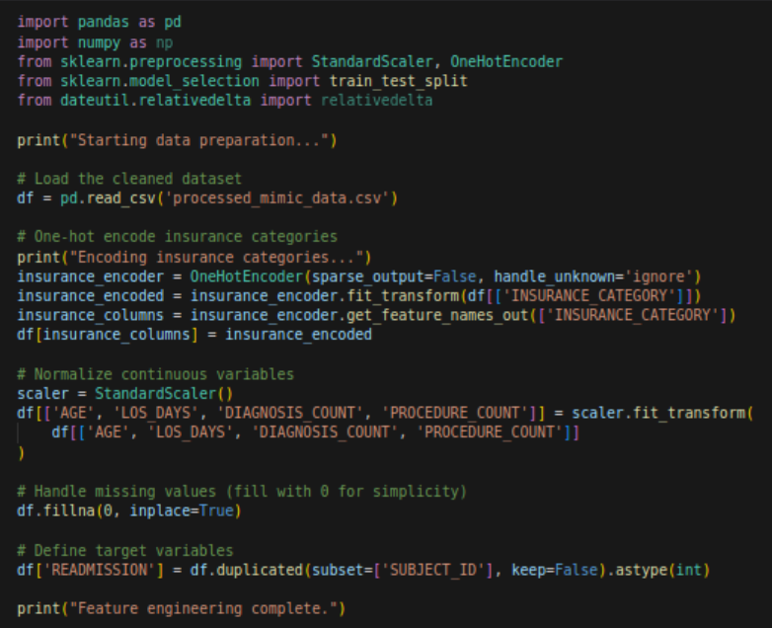
Feature Engineering
Adding Hot Encoded Insurance Categories
Normalizing Age, LOS, and other dataframe data to prepare for machine learning
Filling missing values
Defining target Variables around readmission
Notes:
Key transformations:
One-hot encoding for categorical insurance types.
Normalizing numerical features like age and length of stay.
Handling missing values to ensure robust modeling.
Defining target variables for mortality and readmission prediction.

Slide 10
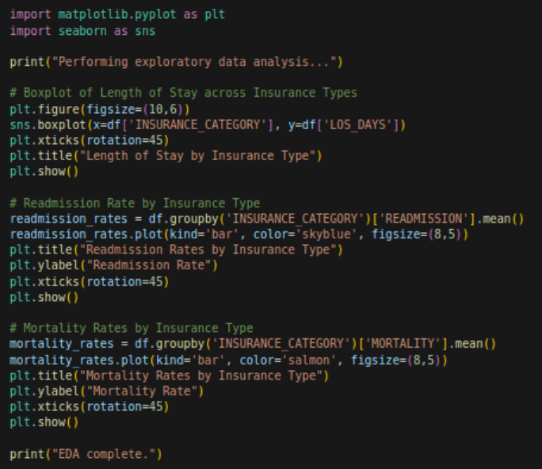
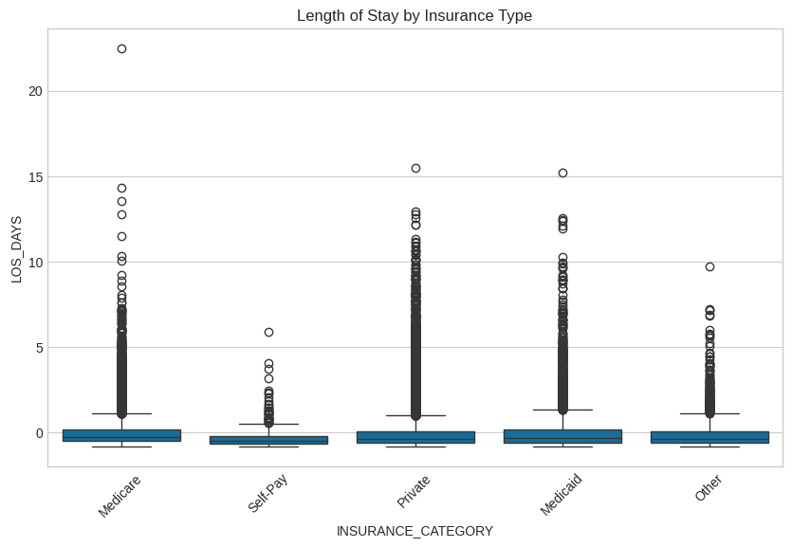
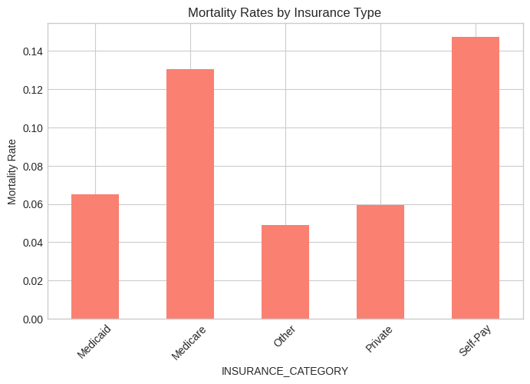
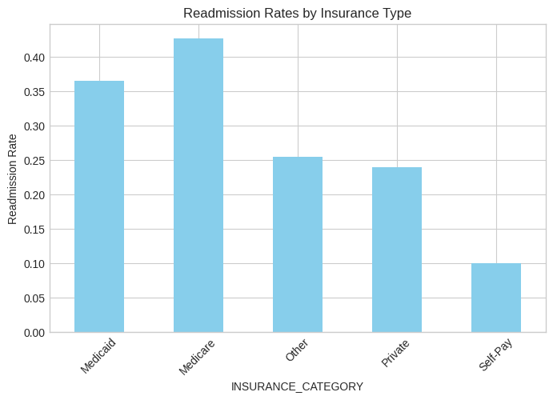
Focused Data Exploration and Plotting
Data gives better analysis of Insurance Specific EDA:
Self pay had the highest mortality rates, followed by medicare (likely because medicare has older patients)
Medicare and medicaid had higher readmission rates (likely due to those individuals requiring more medical services)
Self-Pay Patients had far shorter stays than any other payment type
Private insurers had some of the longest skews towards high lengths of stay
Notes:
More detailed EDA was performed to focus on insurance-specific trends.
Findings:
Self-pay patients had the shortest stays but highest mortality.
Medicare had higher readmission rates, likely due to older patients requiring more care.
These insights guided model selection and feature importance analysis.

Slide 11
Prediction Model for Mortality and Readmission

Slide 12
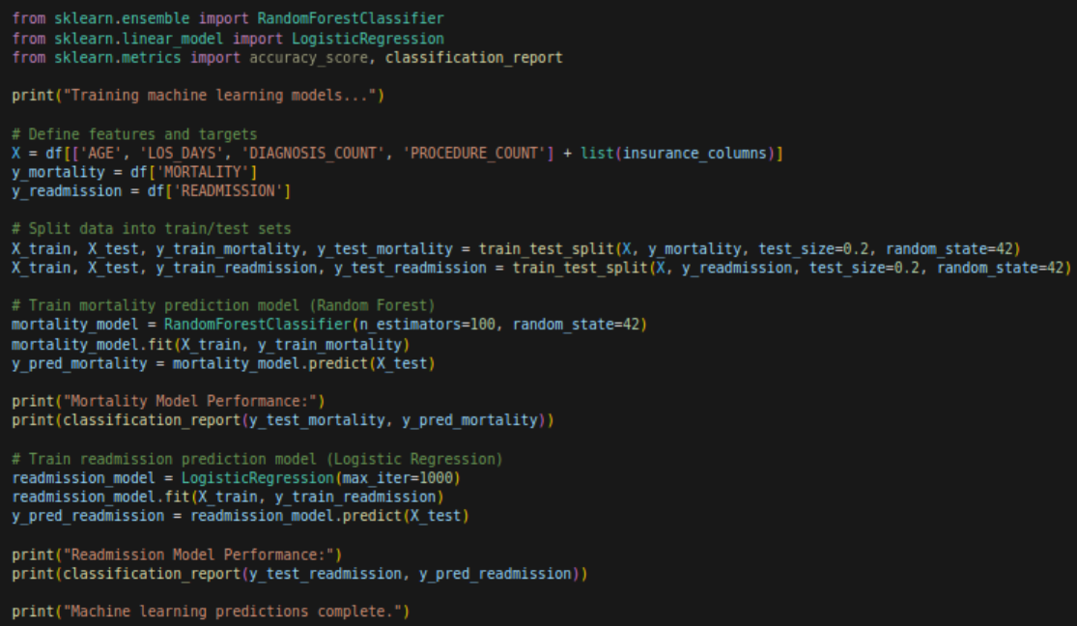
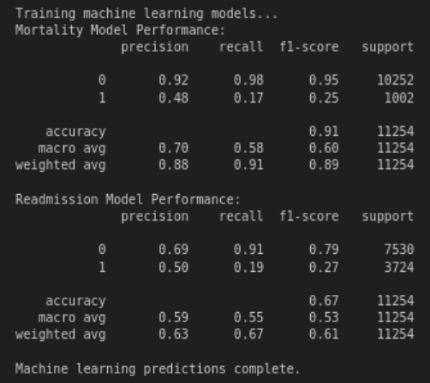
Predicting Mortality and Readmission: Code and Results
Mortality Prediction was easier than Readmission predictions
Overall accuracy was fairly good, but could have been better with more features
Realistically, the focus on age and length of stay gives a good predictor for Mortality (longer stays are more likely to die), but may not provide the granularity needed to understand the likelihood for a condition to lead to subsequent stays
Notes:
Machine learning models were trained to predict mortality and readmission.
Logistic Regression and Random Forest were tested.
Results:
Mortality was easier to predict than readmission.
Length of stay and age were the strongest predictors.
Adding more features could improve predictive accuracy.

Slide 13
PCA, T-SNE, and Advanced Modeling

Slide 14
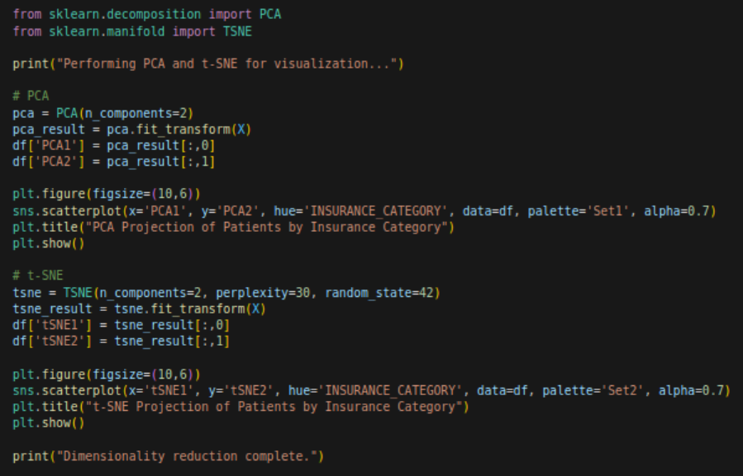
PCA & T-SNE Code
Identify 2 principal components from the dataset
Plot the PCA points by insurance category
Identify 2 principal components of tsne
Plot those with coloration by Insurance Category
Notes:
PCA and T-SNE were used to reduce the complexity of the dataset.
PCA extracted two principal components to visualize insurance-based clusters.
T-SNE provided a more nuanced separation of patient groups.

Slide 15
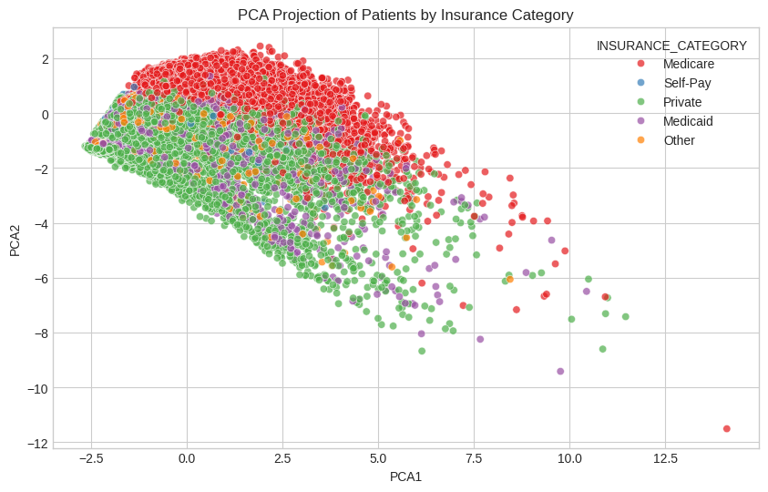
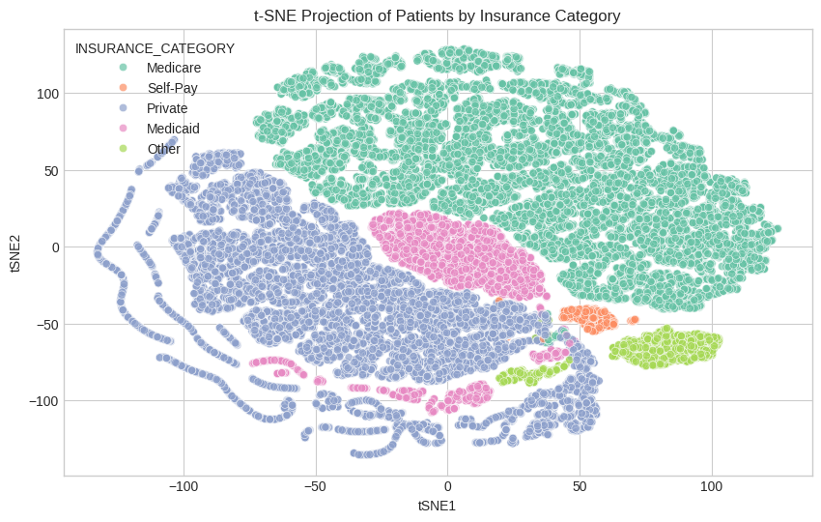
PCA & T-SNE Visualizations
PCA
Medicare seems to be unique in its cases, whereas Medicaid, Other, Self Pay, and Privately insured cases all seem to be intermixed between each other
This could be due to the higher age and types of complications that happen at higher ages
t-SNE
Notice how segregated the different types of insurers are when it comes to the the t-SNE Chart
This could mean that the types of insurance people have has a high predictor of care, even if it does not predict things like readmission rates
Notes:
PCA Results:
Medicare cases appeared more distinct from other insurance groups.
Medicaid, Private, and Self-Pay patients overlapped more.
T-SNE Results:
Clearer separation by insurance type.
This suggests that insurance type is a strong determinant of care patterns.

Slide 16
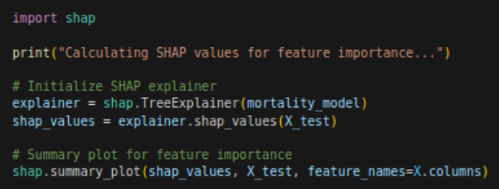
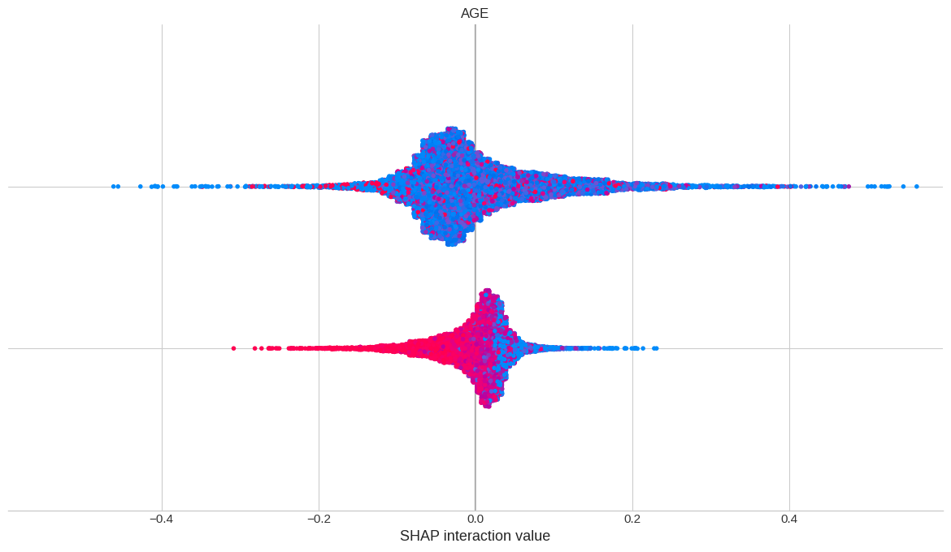
SHAP Feature Importance Extraction: Code & Graph
SHAP summaries show how much an individual feature contributed to a prediction in a dataset
They can be used to explain which features are responsible for predictions
Here we can see Age is a strong predictor of Mortality, as older dots are skewed to be a positive indicator of mortality
Notes:
SHAP values explain which features most impact model predictions.
Findings:
Age strongly influences mortality predictions.
Other key factors: Length of stay and insurance type.
SHAP provides interpretability, ensuring models are not black boxes.

Slide 17
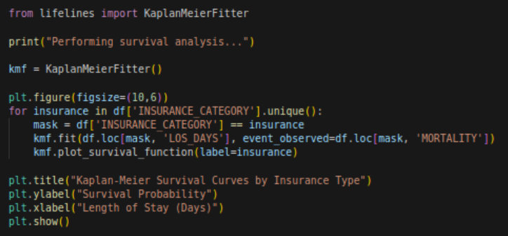
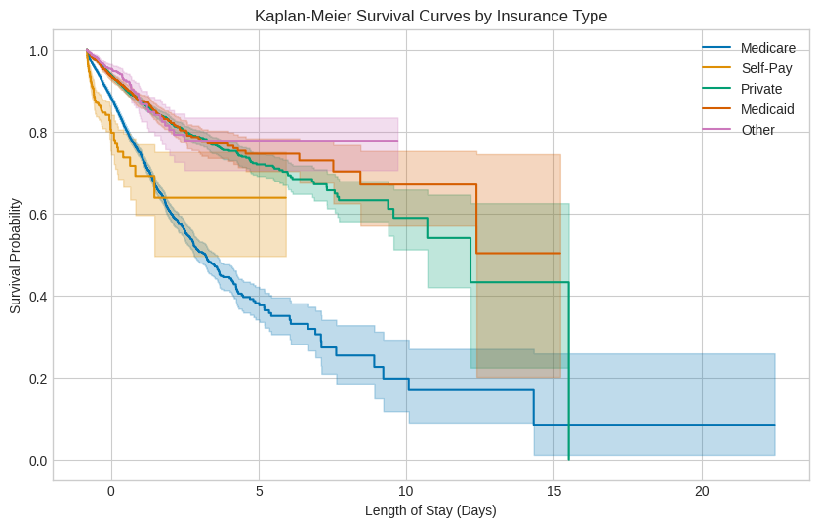
Kaplan-Meier Survival Curves
Analysis Methodology: Applied survival analysis using Kaplan-Meier estimators to MIMIC III clinical data, stratifying patients by insurance type (Medicare, Medicaid, Private, Self-Pay, and Other) to examine the relationship between insurance status and hospital outcomes.
Kaplan-Meier Curve Explained: These curves show the probability of patients "surviving" (not being discharged due to death) over their length of hospital stay, with the colored bands representing 95% confidence intervals; steeper curve declines indicate higher discharge/mortality rates for that insurance group.
Key Findings: Medicare patients (blue line) show significantly worse outcomes with the steepest survival probability decline, while Other patients (purple) demonstrate the highest survival probability over time; this suggests potential disparities in clinical outcomes associated with insurance status that warrant further investigation into social determinants of health and treatment variations.
Notes:
Kaplan-Meier analysis was applied to study survival probabilities by insurance type.
Interpretation:
Medicare patients had the worst outcomes, with the steepest decline in survival probability.
"Other" insurance types had the highest survival probability.
These results indicate disparities in treatment and health outcomes.

Slide 18
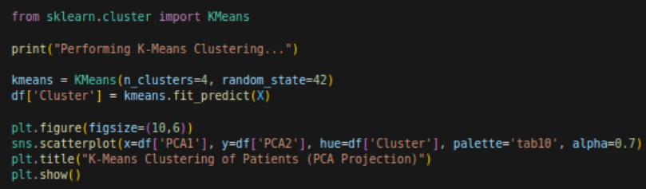
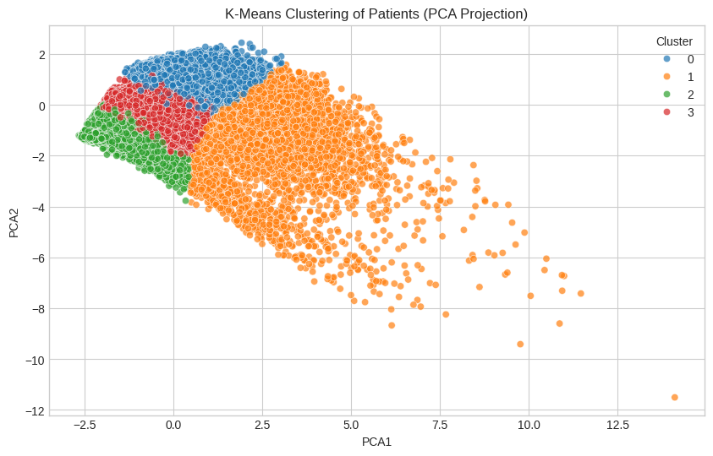
K-Means on PCA components
Dimensionality Reduction + Clustering Technique: Applied Principal Component Analysis (PCA) to transform complex patient data from MIMIC III into two principal components (PCA1 and PCA2) that capture maximum variance, followed by K-means clustering to identify 4 distinct patient subgroups.
Visualization Analysis: The scatter plot reveals well-defined patient clusters with unique distribution patterns—cluster 0 (blue) forms a concentrated group in the upper region, clusters 2 (green) and 3 (red) appear as compact segments, while cluster 1 (orange) shows a distinctive elongated distribution with significant spread along both axes.
Clinical Implications: These patient subgroups likely represent meaningful clinical phenotypes with distinct characteristics and potentially different treatment needs; the outliers in cluster 1 extending into the lower right quadrant may represent patients with unusual or complex clinical presentations worthy of specific investigation. This is best compared to the previous graph which illustrated different insurance types of the same graph.
Notes:
K-Means clustering was performed on PCA-transformed data.
Four distinct patient subgroups emerged.
These clusters may represent different clinical profiles with unique treatment needs.
The scatter plot shows distinct clusters of patients.
Insights:
Some clusters are tightly grouped, others more spread out.
The elongated cluster may represent complex medical cases.
This technique provides a way to segment patients for tailored care.

Slide 19
Summary of Key Findings
Key takeaways:
Insurance type significantly impacts healthcare outcomes.
Mortality and readmission rates vary across insurance groups.
PCA, T-SNE, and clustering provide deeper insights into patient segmentation.
ML models can predict mortality with reasonable accuracy.
Future work could explore additional features to improve model performance.

